Slide 1
Rotating Frame Analysis (Vectors)
Dr. Agnes d’Entremont
Associate Professor of Teaching
Mechanical Engineering, University of British Columbia

Slide 2
Relative Motion Analysis: rigid/pinned versus sliding/separate
The relative motion analysis using translating coordinate frames works for finding velocities and accelerations of points on rigid bodies that are rigidly connected or pinned together
If one body is sliding with respect to another body (e.g. a box sliding off a rotating ramp), or the two bodies are entirely separate (two airplanes travelling on separate arcs), then we need to use a rotating coordinate frame which rotates with one of the bodies.

Slide 3
Rotating Frames
The most general relative motion equation
Fixed axis rotation and translating frames are special cases
Can always use the rotating frames equation
The most complex relative motion equation
We often use one of the special cases if we can

Slide 4



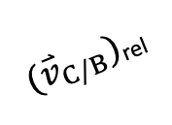





Rotating Frames
When considering relative motion analysis previously, we created a series of coordinate frames that translated (not rotated) with the body.
Now, we need a frame that rotates with the body. We will use x’ and y’ for this frame.
Collar C is sliding against BD.
The rotating frame is attached at B, rotating with BD.
$$y′$$
${(\overset{⃑}{v}}_{C/B})$_{rel}
D
$$x′$$
C
$$ϕ$$
B
$$y_{1}$$
$$Y$$
$$θ$$
$$x_{1}$$
$$X$$
O
A

Slide 5

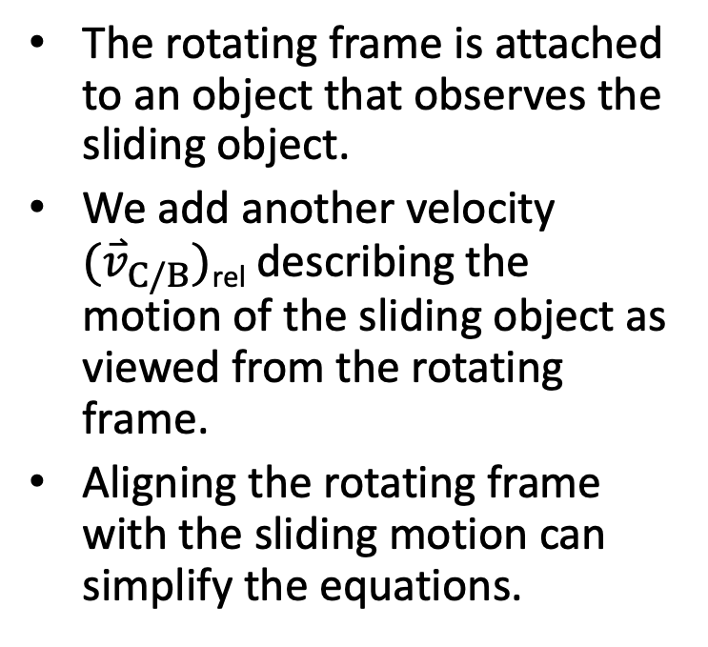
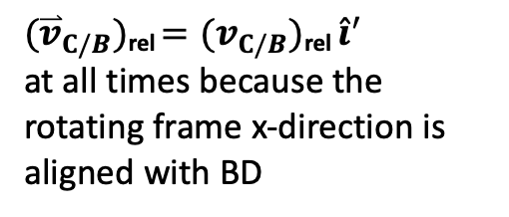
Rotating Frames
The rotating frame is attached to an object that observes the sliding object.
We add another velocity ${(\overset{⃑}{v}}_{C/B})$_{rel} describing the motion of the sliding object as viewed from the rotating frame.
Aligning the rotating frame with the sliding motion can simplify the equations.
Collar C is sliding against BD.
The rotating frame is attached at B, rotating with BD.
$$y′$$
${(\overset{⃑}{v}}_{C/B})$_{rel}
D
$$x′$$
C
$$ϕ$$
B
$$y_{1}$$
$$Y$$
${(\overset{⃑}{v}}_{C/B})$_{rel} $={(v}_{C/B})\text{rel} {\hat{i}}^{′}$
at all times because the rotating frame x-direction is aligned with BD
$$θ$$
$$x_{1}$$
$$X$$
O
A

Slide 6



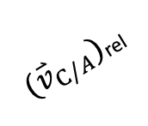

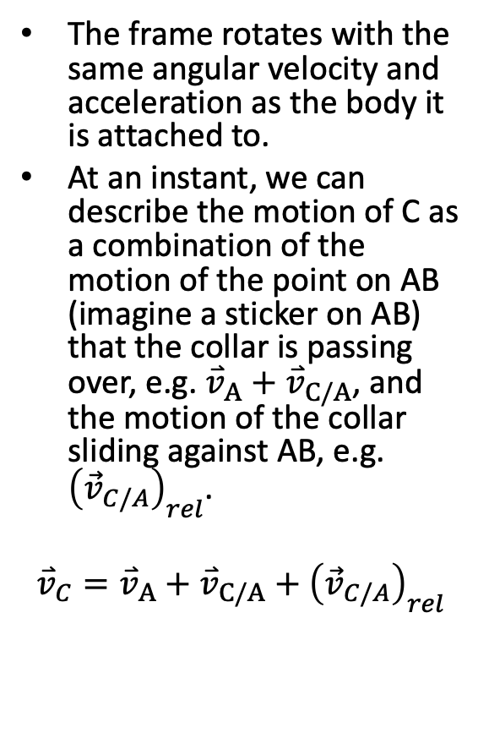


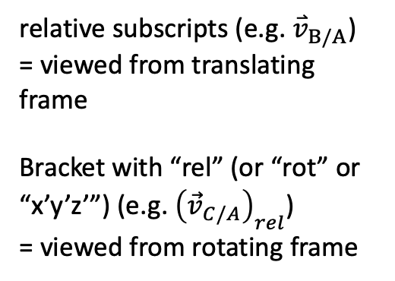




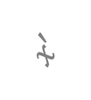
Meaning of Relative Motion Equations
The frame rotates with the same angular velocity and acceleration as the body it is attached to.
At an instant, we can describe the motion of C as a combination of the motion of the point on AB (imagine a sticker on AB) that the collar is passing over, e.g. ${\overset{⃑}{v}}_{A}+{\overset{⃑}{v}}_{C/A}$, and the motion of the collar sliding against AB, e.g. ${\left({\vec{v}}_{C/A}\right)}_{rel}$.
$${\overset{⃑}{v}}_{C}={\overset{⃑}{v}}_{A}+{\overset{⃑}{v}}_{C/A}+{\left({\vec{v}}_{C/A}\right)}_{rel}$$
$$y′$$
$${\overset{⃑}{v}}_{C/A}$$
$$\vec{ω}$$
$$y′$$
$$y′$$
B
$$x′$$
${(\overset{⃑}{v}}_{C/A})$_{rel}
$$x′$$
$$x′$$
$${\overset{⃑}{v}}_{A}$$
A
relative subscripts (e.g. ${\overset{⃑}{v}}_{B/A}$)
= viewed from translating frame
Bracket with “rel” (or “rot” or “x’y’z’”) (e.g. ${\left({\vec{v}}_{C/A}\right)}_{rel}$)
= viewed from rotating frame
$$Y$$
O
$$X$$
CC BY binocular by iconcheese from the Noun Project

Slide 7
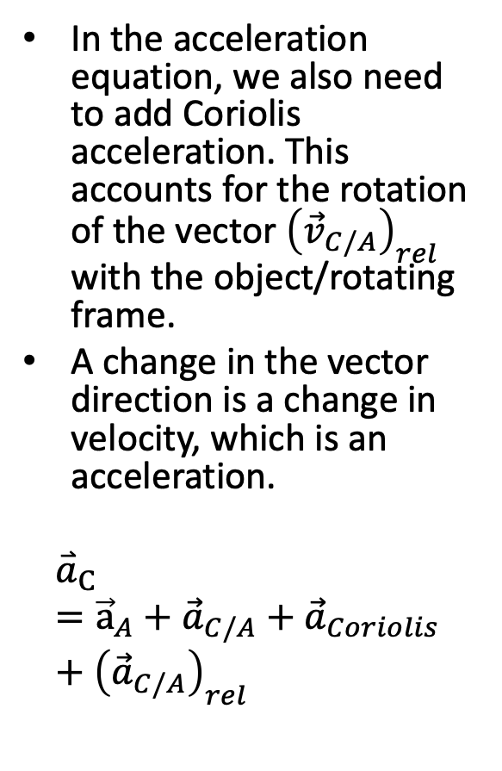
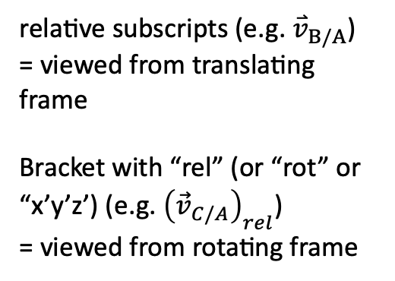
Meaning of Relative Motion Equations
In the acceleration equation, we also need to add Coriolis acceleration. This accounts for the rotation of the vector ${\left({\vec{v}}_{C/A}\right)}_{rel}$ with the object/rotating frame.
A change in the vector direction is a change in velocity, which is an acceleration.
$${\overset{⃑}{a}}_{C}={\vec{a}}_{A}+{\vec{a}}_{C/A}+{\vec{a}}_{Coriolis}+{\left({\vec{a}}_{C/A}\right)}_{rel}$$
$$y′$$
$${\overset{⃑}{v}}_{C/A}$$
$$\vec{ω}$$
$$y′$$
$$y′$$
B
$$x′$$
${(\overset{⃑}{v}}_{C/A})$_{rel}
$$x′$$
$$x′$$
$${\overset{⃑}{v}}_{A}$$
A
relative subscripts (e.g. ${\overset{⃑}{v}}_{B/A}$)
= viewed from translating frame
Bracket with “rel” (or “rot” or “x’y’z’) (e.g. ${\left({\vec{v}}_{C/A}\right)}_{rel}$)
= viewed from rotating frame
$$Y$$
O
$$X$$
CC BY binocular by iconcheese from the Noun Project

Slide 8
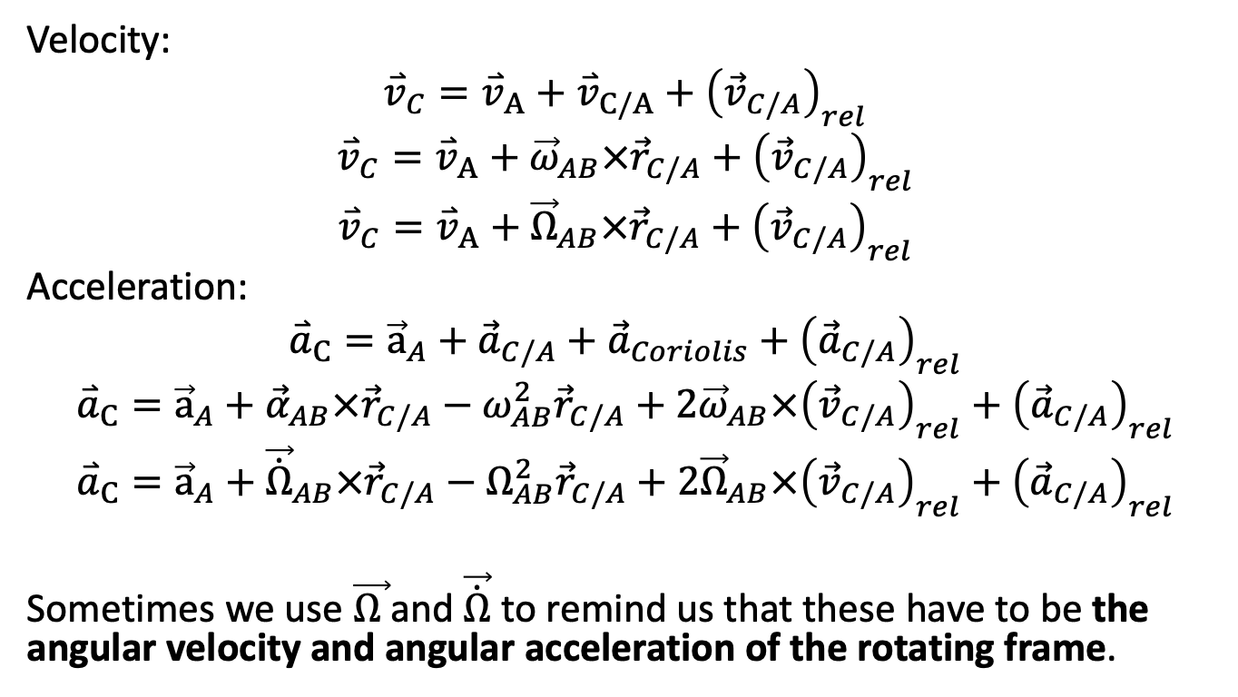
Final rotating frame equations
Velocity:
$${\overset{⃑}{v}}_{C}={\overset{⃑}{v}}_{A}+{\overset{⃑}{v}}_{C/A}+{\left({\vec{v}}_{C/A}\right)}_{rel}$$
$${\overset{⃑}{v}}_{C}={\overset{⃑}{v}}_{A}+{\vec{ω}}_{AB}×{\vec{r}}_{C/A}+{\left({\vec{v}}_{C/A}\right)}_{rel}$$
$${\overset{⃑}{v}}_{C}={\overset{⃑}{v}}_{A}+{\vec{Ω}}_{AB}×{\vec{r}}_{C/A}+{\left({\vec{v}}_{C/A}\right)}_{rel}$$
Acceleration:
$${\overset{⃑}{a}}_{C}={\vec{a}}_{A}+{\vec{a}}_{C/A}+{\vec{a}}_{Coriolis}+{\left({\vec{a}}_{C/A}\right)}_{rel}$$
$${\overset{⃑}{a}}_{C}={\vec{a}}_{A}+{\vec{α}}_{AB}×{\vec{r}}_{C/A}−ω_{AB}^{2}{\vec{r}}_{C/A}+2{\vec{ω}}_{AB}×{\left({\vec{v}}_{C/A}\right)}_{rel}+{\left({\vec{a}}_{C/A}\right)}_{rel}$$
$${\overset{⃑}{a}}_{C}={\vec{a}}_{A}+{\vec{\dot{Ω}}}_{AB}×{\vec{r}}_{C/A}−Ω_{AB}^{2}{\vec{r}}_{C/A}+2{\vec{Ω}}_{AB}×{\left({\vec{v}}_{C/A}\right)}_{rel}+{\left({\vec{a}}_{C/A}\right)}_{rel}$$
Sometimes we use $\vec{Ω }$and $\vec{\dot{Ω}}$ to remind us that these have to be the angular velocity and angular acceleration of the rotating frame.

Slide 9
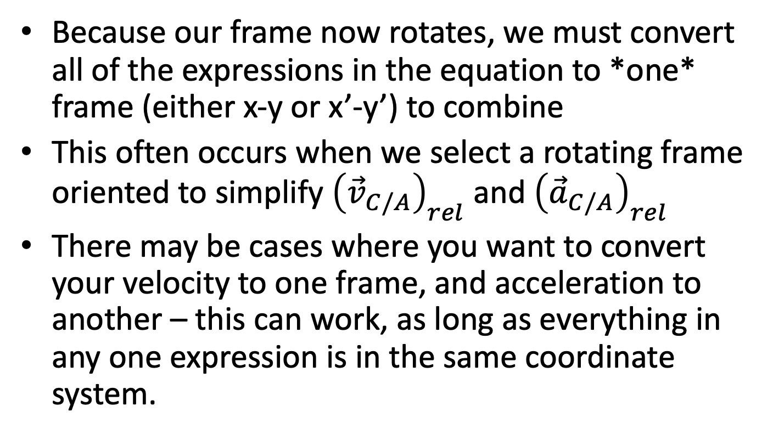
Dealing with Multiple Coordinate Systems
Because our frame now rotates, we must convert all of the expressions in the equation to *one* frame (either x-y or x’-y’) to combine
This often occurs when we select a rotating frame oriented to simplify ${\left({\vec{v}}_{C/A}\right)}_{rel}$ and ${\left({\vec{a}}_{C/A}\right)}_{rel}$
There may be cases where you want to convert your velocity to one frame, and acceleration to another – this can work, as long as everything in any one expression is in the same coordinate system.

Slide 10
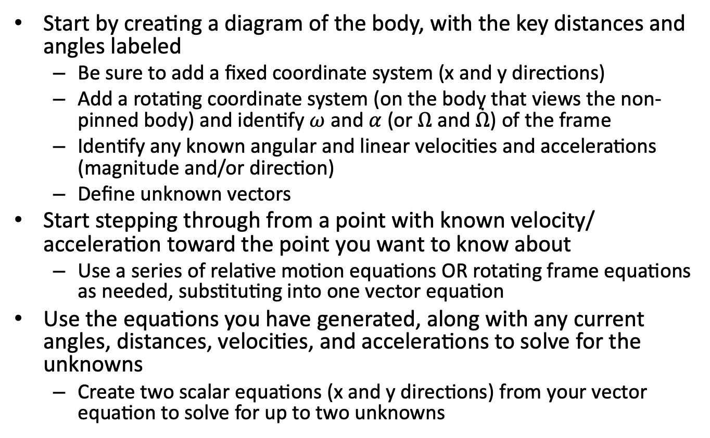
Rotating Frames Analysis Process
Start by creating a diagram of the body, with the key distances and angles labeled
Be sure to add a fixed coordinate system (x and y directions)
Add a rotating coordinate system (on the body that views the non-pinned body) and identify $ω$ and $α$ (or $Ω$ and $\dot{Ω}$) of the frame
Identify any known angular and linear velocities and accelerations (magnitude and/or direction)
Define unknown vectors
Start stepping through from a point with known velocity/ acceleration toward the point you want to know about
Use a series of relative motion equations OR rotating frame equations as needed, substituting into one vector equation
Use the equations you have generated, along with any current angles, distances, velocities, and accelerations to solve for the unknowns
Create two scalar equations (x and y directions) from your vector equation to solve for up to two unknowns

Slide 11
Hints for Rotating Frames
Think about placement/orientation of your rotating frame to reduce the algebra work in your solution
Write out the whole equation, and make sure you don’t miss any terms
Be clear in each equation which frame (xyz or x’y’z’) is being used
Take your time with this analysis – it can be challenging

Slide 12
Thanks for Watching
See other engineering mechanics videos and access the full tool at…

Slide 13
Worked Example
The robotic arm shown below has a fixed orange base at A and fixed length members AB and BC. Motors at A and B allow for rotational motion at the joints. Based on the angular velocities and accelerations shown at each joint, determine the velocity and the acceleration of the end effector at C.
y
A
3 ft
B
x
30º
5 rad/s
3 rad/s
-2 rad/s²
.2 rad/s²
2 ft
C

Slide 14
y
A
3 ft
B
x
30º
5 rad/s
3 rad/s
-2 rad/s²
.2 rad/s²
2 ft
C

Slide 15


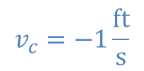
Worked Example
The robotic arm from the previous problem is in the configuration shown below. Assume that theta is currently 30 degrees and that point C currently lies along the x axis. If we want the end effector at C to travel 1 ft/s in the negative x direction, what should the angular velocities be at joints A and B?
y
B
3 ft
2 ft
$$ϕ$$
$$θ$$
x
$$v_{c}=−1\frac{ft}{s}$$
A
C

Slide 16
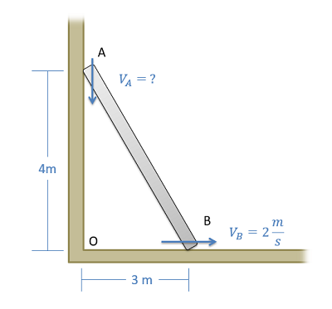
Worked Example
A ladder is propped up against a wall as shown below. If the base of the ladder is sliding out at a speed of 2 m/s, what is the speed of the top of the ladder?

Slide 17
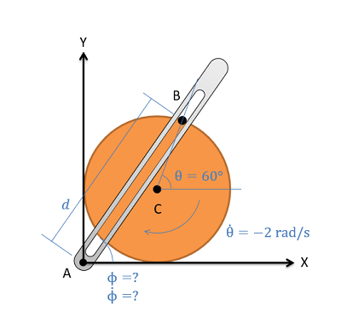
Worked Example
The crank-rocker mechanism as shown below consists of a crank with a radius of .5 meters rotating about its fixed center at C at a constant rate of 2 rad/s clockwise. Rocker AB fixed at it's base at A and connects to point B along the edge of the crank. The pin at point B can slide along a frictionless slot in AB. In the current state, what is the angular velocity of rocker AB?

